Slide 1
INSTALLATION INSTRUCTIONS FOR EXAM

Slide 2
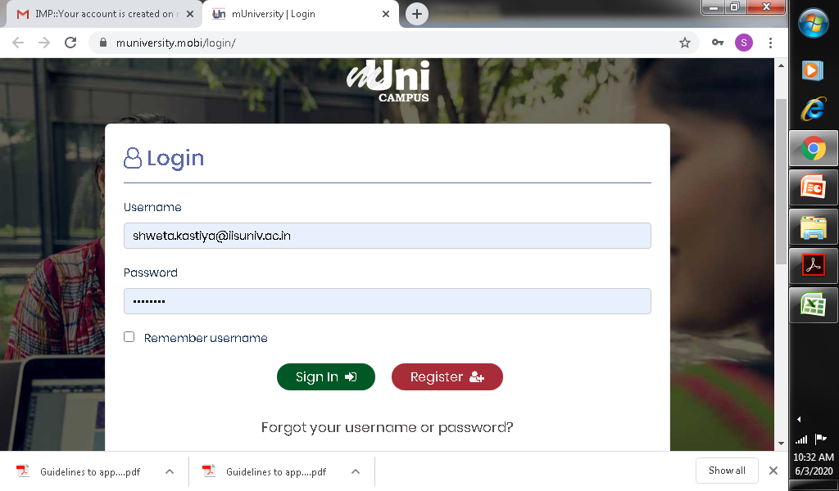
STEP1: Login Url : https://www.muniversity.mobi/login
STEP 2: Please check your email ID from IIS University. You must have received an email from info@muniversity.mobi.
KINDLY NOTE DOWN THE EMAIL ID AND PASSWORD ON PAPER AS YOU WON’T BE ALLOWED TO COPY AND PASTE.

Slide 3
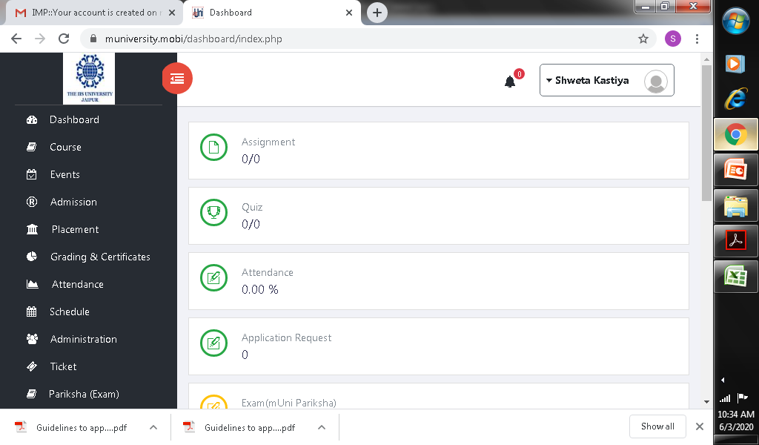
Step 3: Now you will enter the Dashboard, here please click on PARIKSHA TAB as shown in below image.
CLICK HERE

Slide 4
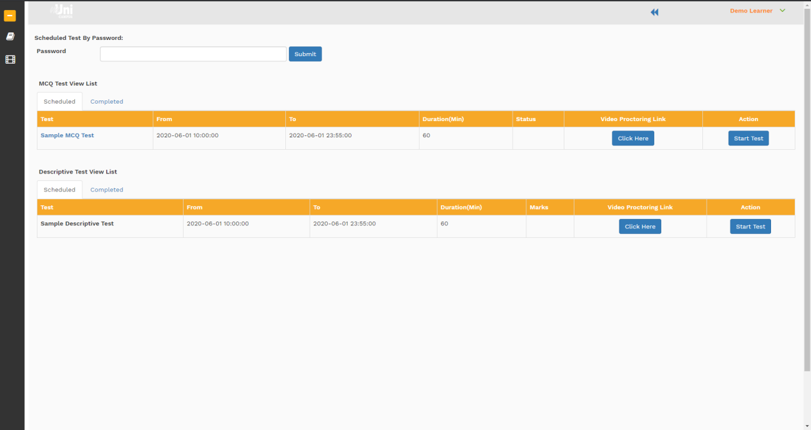
Step 4: Kindly click on the start test option to install the safe browser. Kindly use MCQ test view for attempting paper.

Slide 5
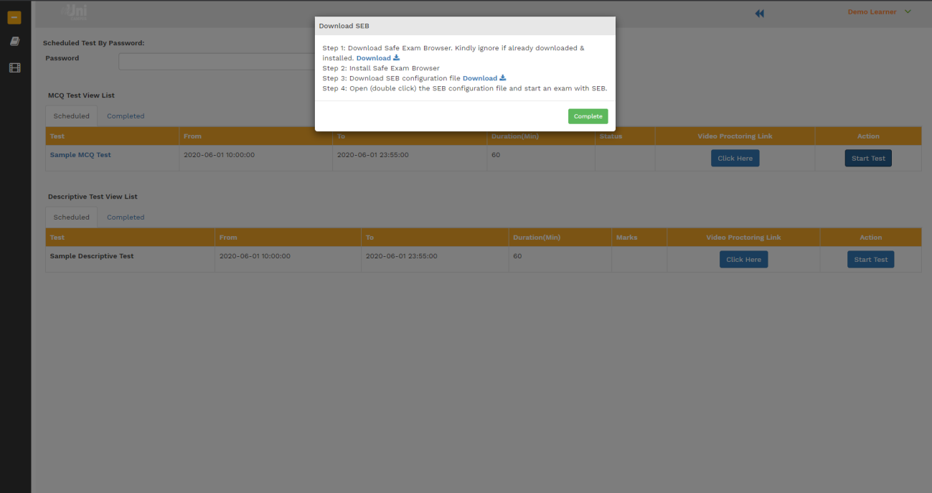
Step 5: Now you will get the below pop-up as shown on the screen. Now click on the first Download option.
CLICK HERE

Slide 6
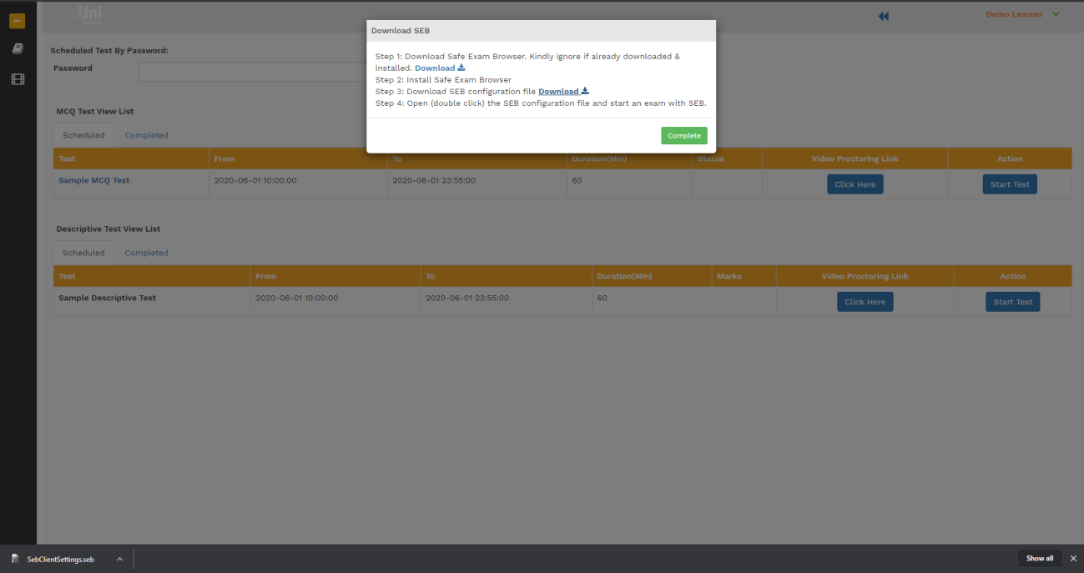
Step 6: Please open the downloaded software as shown in the below image:
CLICK HERE

Slide 7
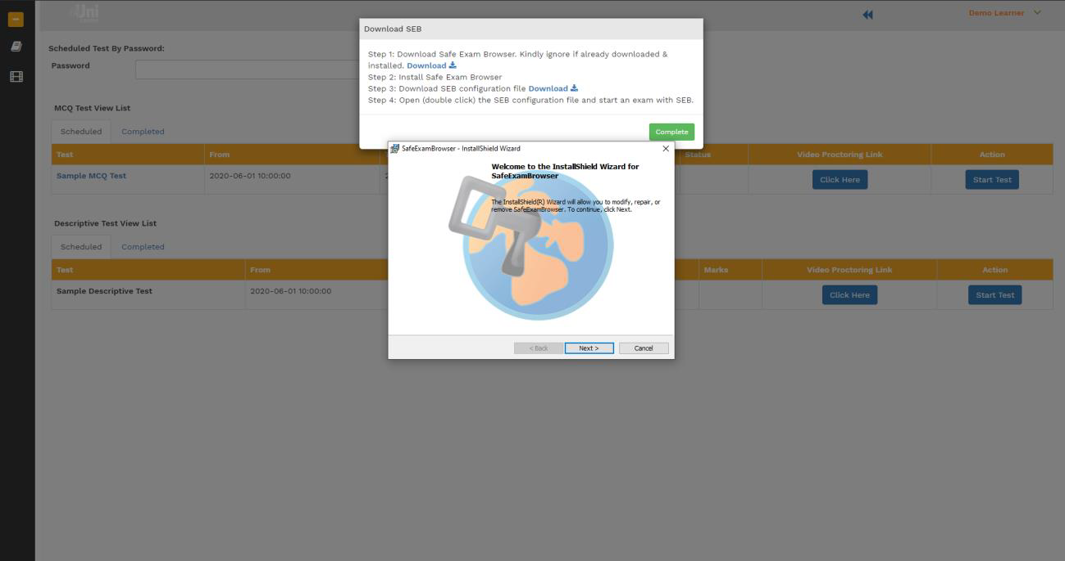
Step 7: You will get the below pop-up to install the safe browser. Here click on the “NEXT” and follow instructions.

Slide 8
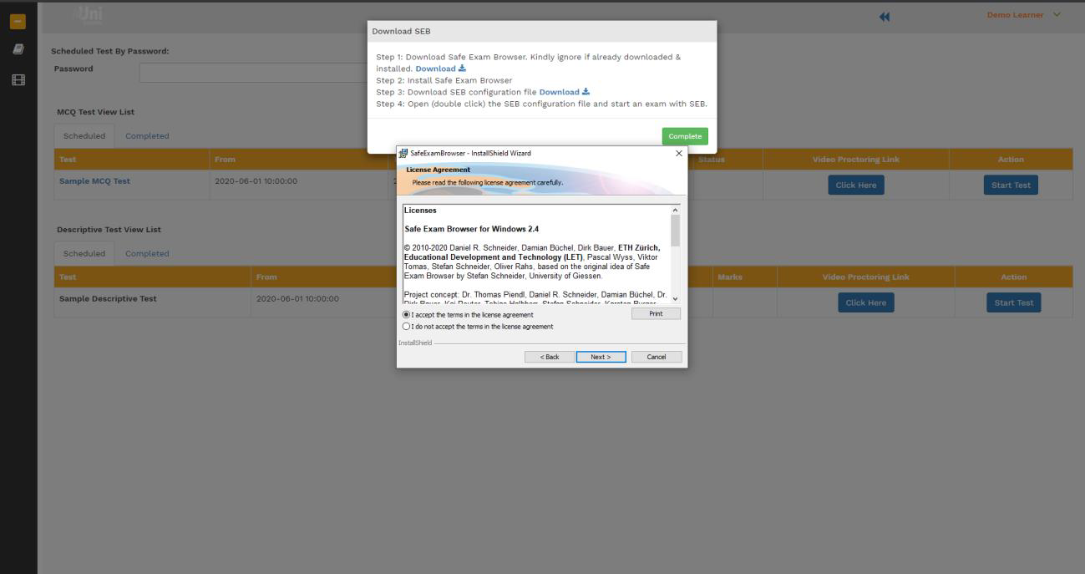
Step 8: Here select the “I accept the terms in the license agreement” and click on NEXT.

Slide 9
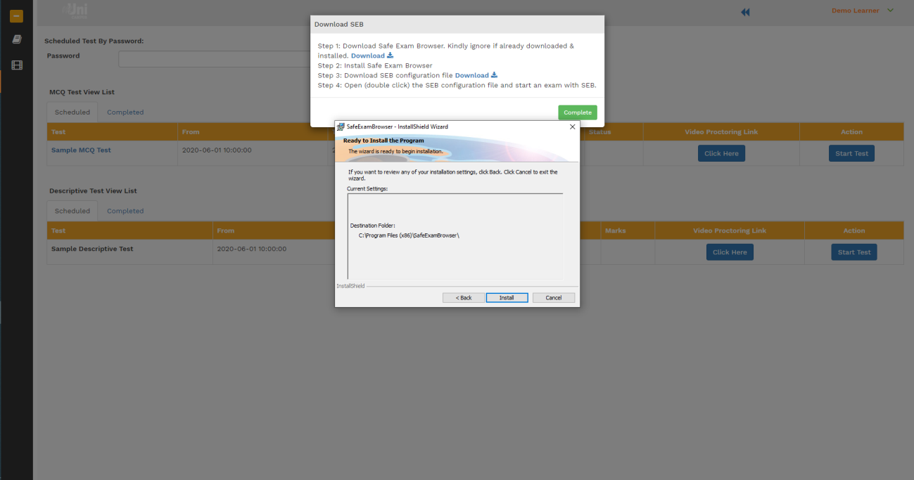
Step 9: Now at this screen click on “INSTALL” to install the safe browser

Slide 10
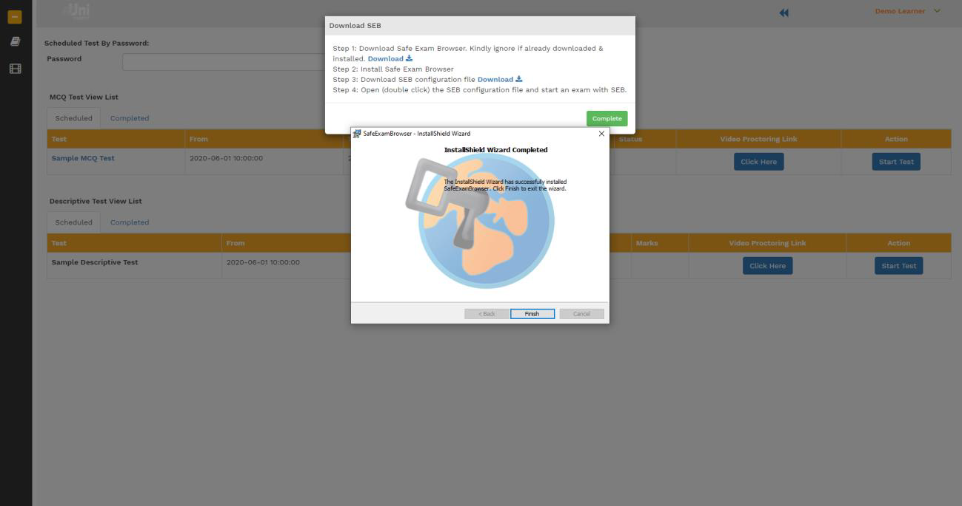
Step 10: Now click on “FINISH” to complete the installation process.

Slide 11
Step 11: Now click on 2nd DOWNLOAD option to download the “SEB Configuration” Kindly go to step 5 for downloading 2nd DOWNLOAD
Once the SEB Configuration is downloaded – Double click on it and you will enter the safe browser mode.

Slide 12
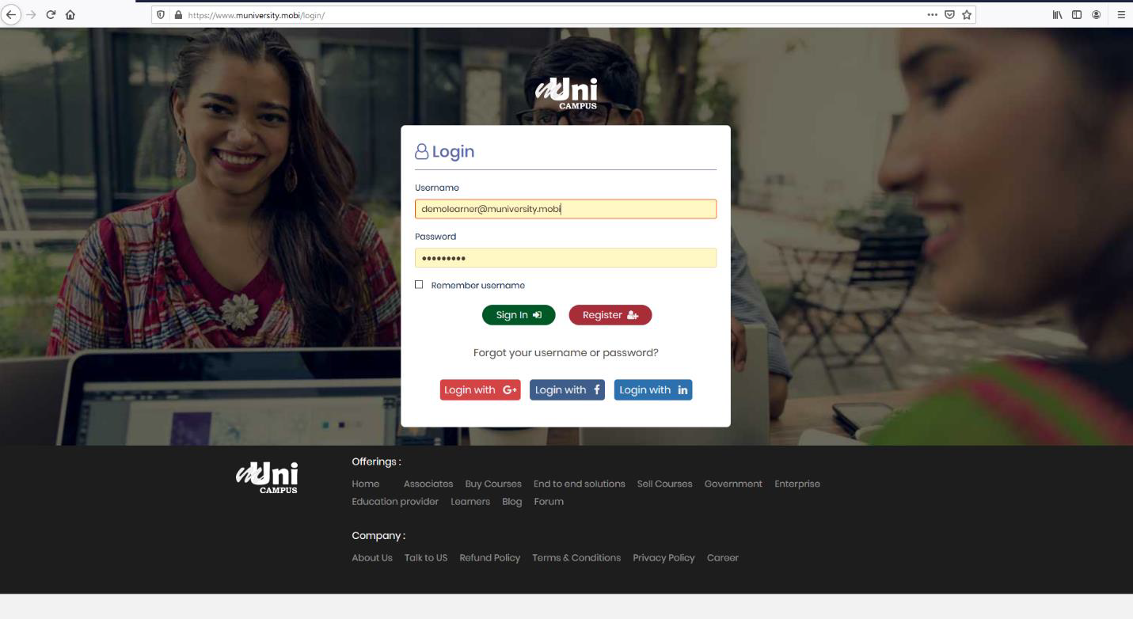
Step 12: You will now again be redirected to the www.muniversity.mobi platform. Click on login and enter your user id and password to login to your account

Slide 13
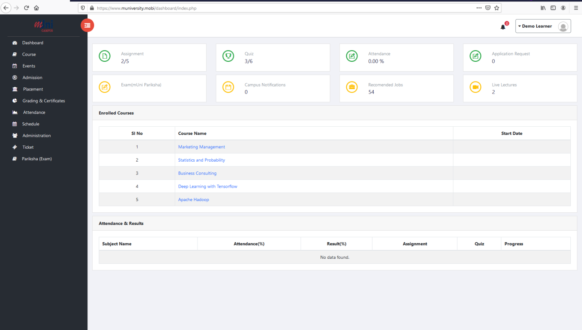
Step 13: Now you will enter the Dashboard. Here click on Pariksha tab.
CLICK HERE

Slide 14
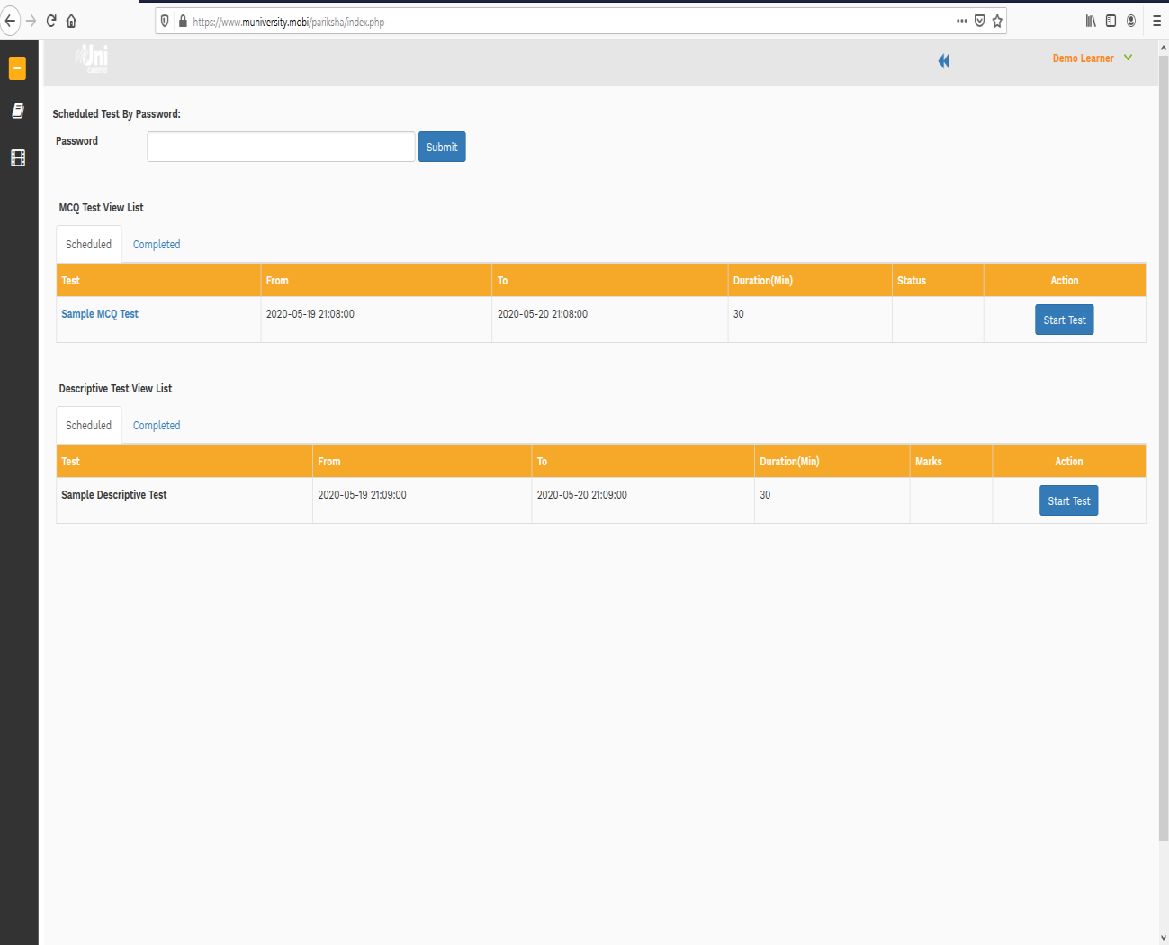
Step 14: Now you will enter the Pariksha tab. Please follow the instructions as shown in the below image

Slide 15
Step 15: Once you click on MCQ test it will take you to the below screen. Here please follow the below process:
a. Enable your camera to capture your image for Proctoring.
b. Once the camera is enabled, hold any Identity card in your hand.
c. Now click on “Take Photo ID Picture” and the picture of your Identity card will be captured and be visible in the “Picture Preview” box.
d. Now click on “Upload” to save the picture.
e. You will get notification of “Photo ID Picture uploaded successfully”
f. Now allow the camera to capture your own picture
g. Then Click on “Take Picture” to capture your image
h. Then click on “Upload” to save the picture.
i. You will get notification of “Photo uploaded successfully”
j. Now read the guidelines and click on “I agree terms and condition”
k. Now at the bottom of the page click on “Start Test” to begin with the MCQ test.

Slide 16
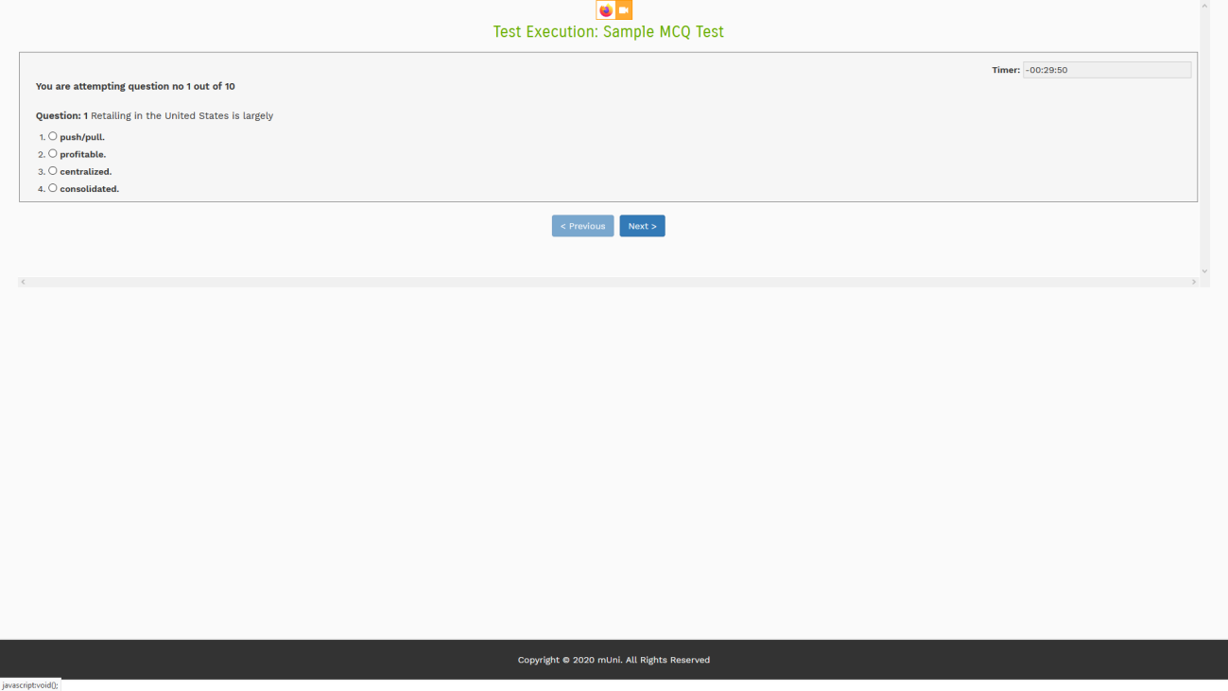
Step 16: Here you will be redirected to the MCQ test screen:
Here select the correct and click on “NEXT” button to go to next question.

Slide 17
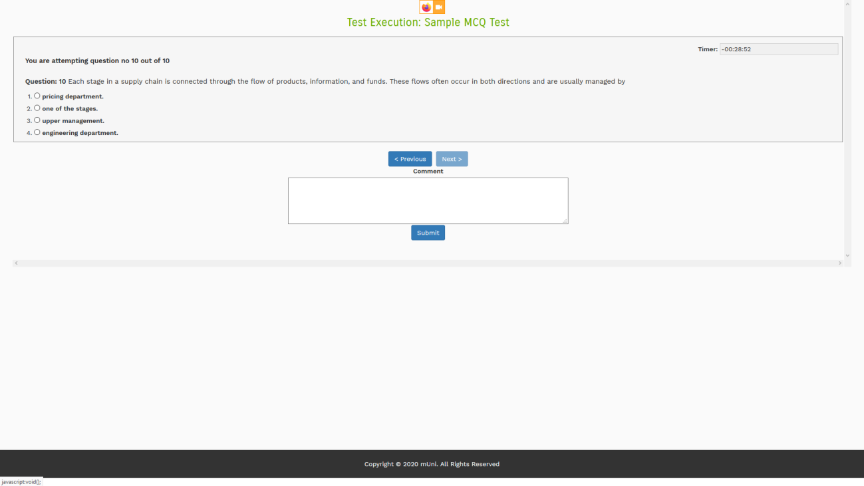
Step 17: At the last question you will be redirected to the below page: Here click on “SUBMIT Button to submit your test

